Slide 1


Qa/qc aspects of readymix concrete
KOWSHIKA.V.R
Director
QCRETE READYMIX(INDIA) Pvt Ltd

Slide 2


Slide 3


Slide 4
P
I G

Slide 5
Water-cement Ratio
Key to strength ,all engineering properties
Weight of water/weight of CEMENT.
Curing is the process by which enough moisture is maintained in the body of concrete for proper hydration of CEMENT.
CAPILLARIES; capillaries are formed during the curing process. They are unwanted small tunnels left behind after excess water(water not needed for cement hydration but needed for flowability) has evaporated from the concrete.

Slide 6
CAPILLARIES
To keep the capillary formation to a minimum we have to
A) keep the water cement ratio to a minimum
B)Contol the curing and cure as long as possible.
C)use of WRA/HRWRA
D)do all A,B,C together.
WHY DO CAPILLARIES MAKE CONCRETE WEAK
Because they take up space that should be filled with concrete. They act as transit system for water/water vapour (moisture) migration.

Slide 7
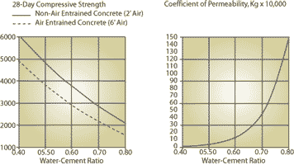

Slide 8
All materials should confirm to IS standard
Ordinary Portland Cement
IS269, IS8112, IS12269
Portland pozzolana cement
IS1489
Portland Slag cement
IS455
Fly ash
IS3812
GGBS
IS12089
Water
IS3025
aggregates
IS2386, IS383
admixture
IS9103

Slide 9
THE FLYASH BENIFITS
BENEFITS OF USING FLY ASH
It will not be too long that we have to find PURE OPC mixes in only some museums
My answer to the use of FLYASH is that we should by now have long since moved from the posture of asking “ should I use fly ash “ to being required to justify a decision not to use fly ash—(B.Mather 1982)

Slide 10
Benefits to the concrete/construction industry.
01. Reduced water requirement for a given slump.
That means concretes can be produced/delivered at lower w/c ratio s.

Slide 11
The flyash benifits
02. Lesser beeding and segregation, and hence better concrete.
03.Improved cohesiveness, placability, pumpability and hence easy concreting with minimum pump problems, protection from minor changes of sand (like becoming coarser).
04. Reduced drying shrinkage, creep.

Slide 12
05. Reduced Permeability.
06. Reduced heat of hydration& potential to thermal cracking.
07. Increased resistance to aggressive environments such as sulphate soils, marine exposure, and chloride ingress.
08. Insurance against potential-aggregate reaction.

Slide 13
The flyash benifits
09. Increased long term strengths
Undoubtedly the flyash + OPC blends give excellent later age strengths; some of the results are given below.
From the trial mix results we can see a minimum of 8t10Mpa addition between 28 to 90 days. There is another addition of around 6 to 8 Mpa between 90 days to 180 days.
The increments in strengths are significant and in many countries like USA, CANADA consultants have started specifying later age strengths like 56 day, 90day strengths.

Slide 14
Series01
Grade | M10 | M15 | M20 | M25 | M30 | M40
Cement+Flyash(kgs) | 165+105 | 195+105 | 215+105 | 255+85 | 270+90 | 340+100
7day strength(mpa) | 9.5 | 11 | 17 | 24.5 | 27.5 | 53.5
28day(strength(mpa) | 15 | 17 | 27 | 33.5 | 34 | 70
90daystrength(mpa) | 22 | 28 | 40 | 43 | 46.5 | 78
Series02
Grade | M25 | M35 | M40 | M55 | M60
Cement+flyash(kgs) | 260+100 | 300+100 | 335+100 | 425+145 | 450+120
7Day strength(mpa) | 18 | 30 | 37 | 47.5 | 55
28 Day strength(mpa) | 32 | 49 | 60 | 67 | 73
Note:Trails done with fly ash from ennure/mettur thermal power plant

Slide 15
Project: Tambaram, Irumpuliyur, Chennai
date of supply | Grade | Opc+pfa | 3 d | 7 d | 28 d | 90d | 150 d | 365 d
30.11.01 | M20 | 240+100 | 18.62 | 23.49 | 37.84 | 45.74 | 53.72 | 55.0
22.12.01 | M20 | 240+100 | 20.81 * | 22.7 | 38.34 | **53.80 | 57.37 | -
 |  |  | * 4 DAYS |  |  | **94 DAYS
Cubes cast at site

Slide 16
PUMP CONCRETE M10 PROJECT: Apartments,Krishnaram Promoters THIRUVANMAYOOR,CHENNAI
 | TRISHUL CONCRETE
 | DATE OF CONCRETE ; 8.04.2002, 9.04.2002
 | OPC | 130 Kg
 | FLY ASH | 155 Kg
 | 7 days | 10.5Mpa,12.00Mpa
 | 28 days | 19Mpa,21Mpa

Slide 17
M60 WITH FLYASH
TRIAL S
OPC=450 KG+PFA=120KG
W/C=0.31
3DAYS STRENGTH=53Mpa
7 Days STRENGTH=65Mpa
28 Days STRENGTH=77Mpa
Admixture= ECMAS HP 902@2.5KG/M3 TO 3.0KG/M3

Slide 19
Benefits to the society
The most important aspect of utilization of fly ash in concrete is its contribution towards reducing global warming.
Since production of cement involves lot carbon dioxide emissions lesser the cement
Utilization, lesser the carbon dioxide emission and hence lesser global warming.
So if we utilize more flyash we are indirectly bringing down the amount of Carbon dioxide emissions and hence reducing the global warming.
Further greater amounts of flyash through proper mix design when used will prevent dumping of large amounts of flyash /flyash wastes to sea /land which will cause environmental disasters.
QCRETE with its customer partners wants to be leader in flyash utilization
To create cleaner/greener environment.

Slide 21
Design mixes
Mixes can be designed as per the guidelines given in IS10262-2019
But comply to IS 456-2000.

Slide 22
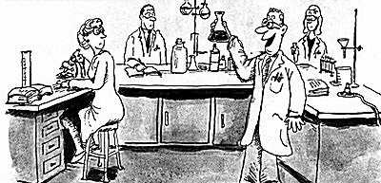
3. Sampling and testing
Sampling and testing shall be as per IS 516, IS 1199 and other relevant Indian or equivalent International standards.

Slide 23
Let us understand sampling properly!!!

Slide 24
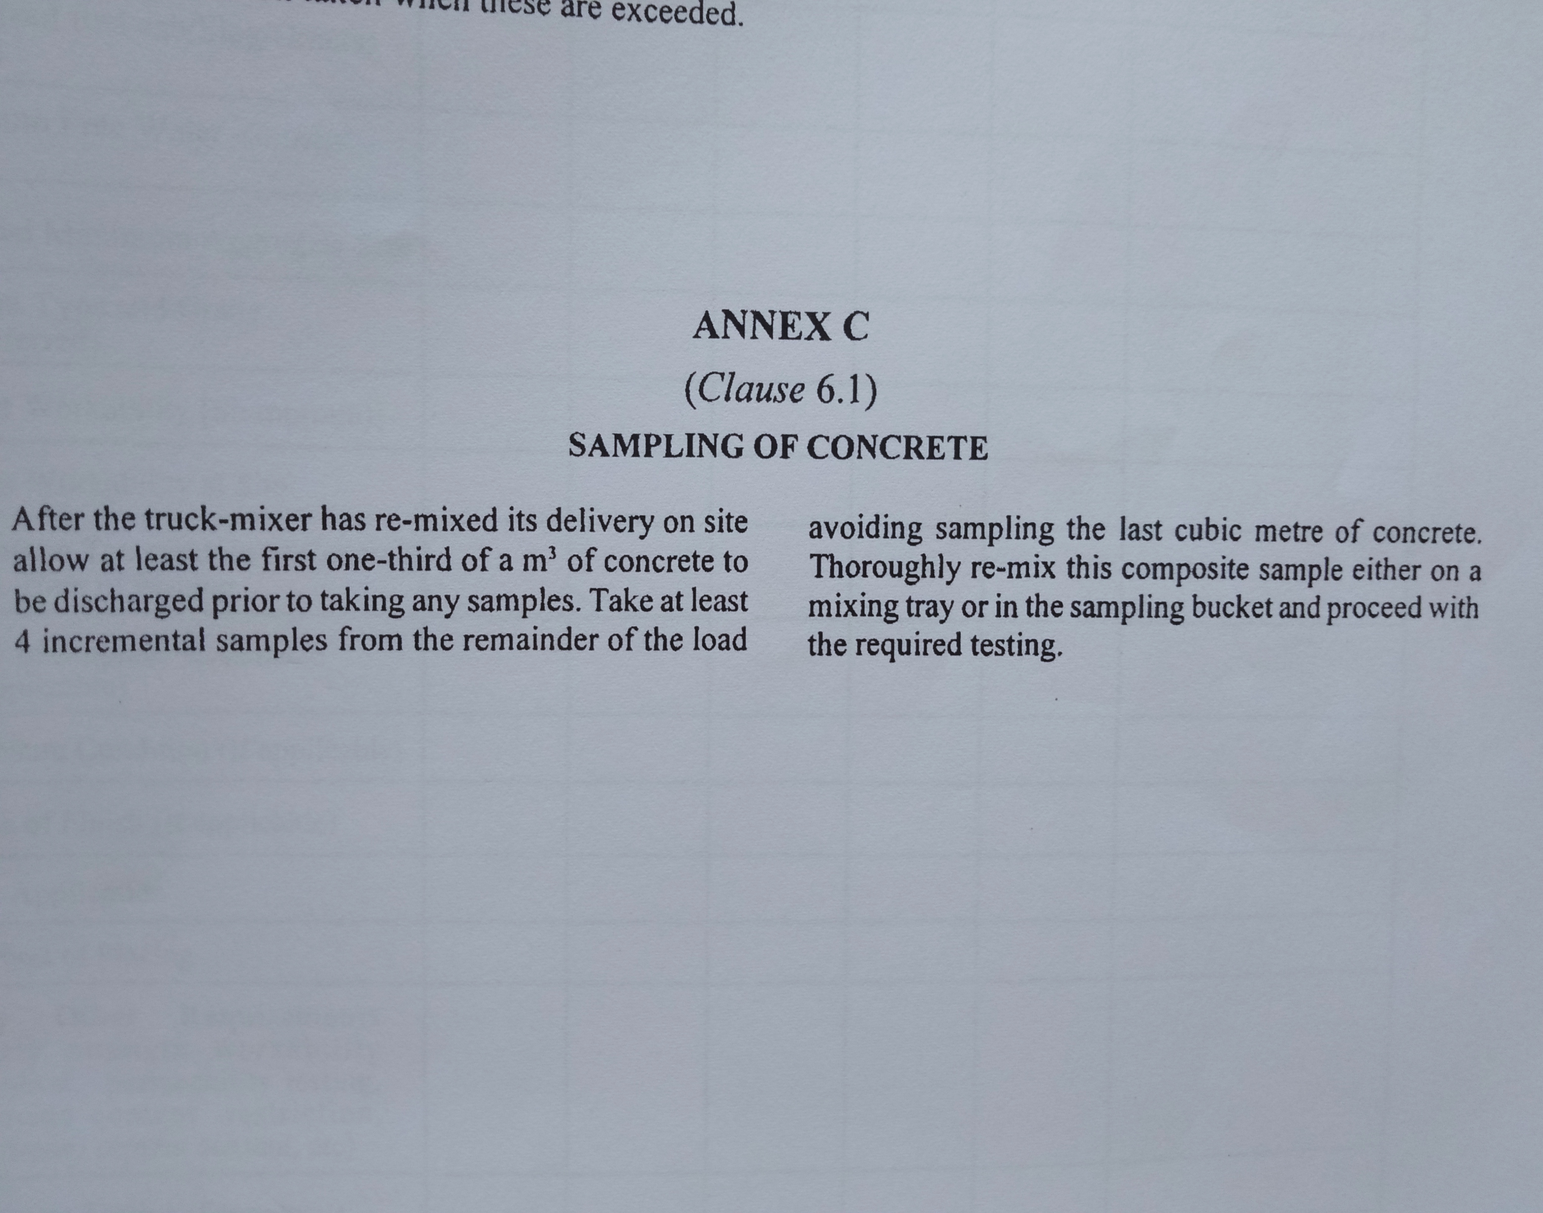
Sampling of concrete:
  As per IS 4926:2003
  Annex C
  Page 11
  Clause 6.1

Slide 25

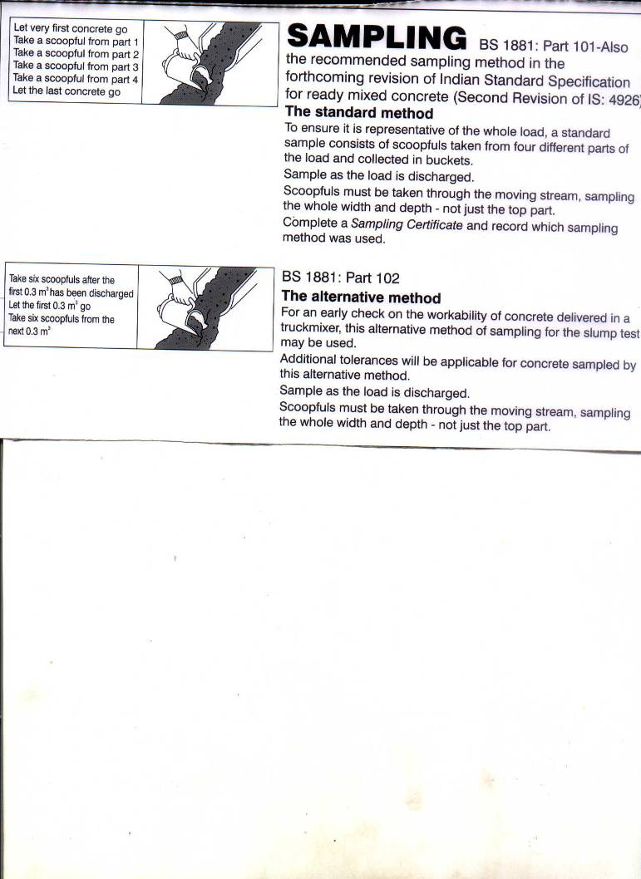
The frequency of testing shall be as per IS 456 OR as mutually agreed with the customer by the producer of concrete.

Slide 26
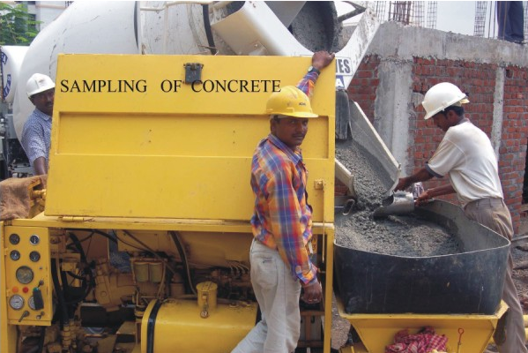

Slide 27
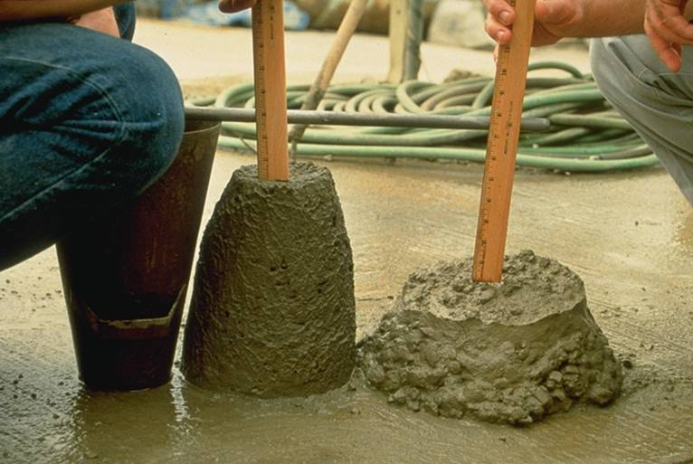

Slide 28
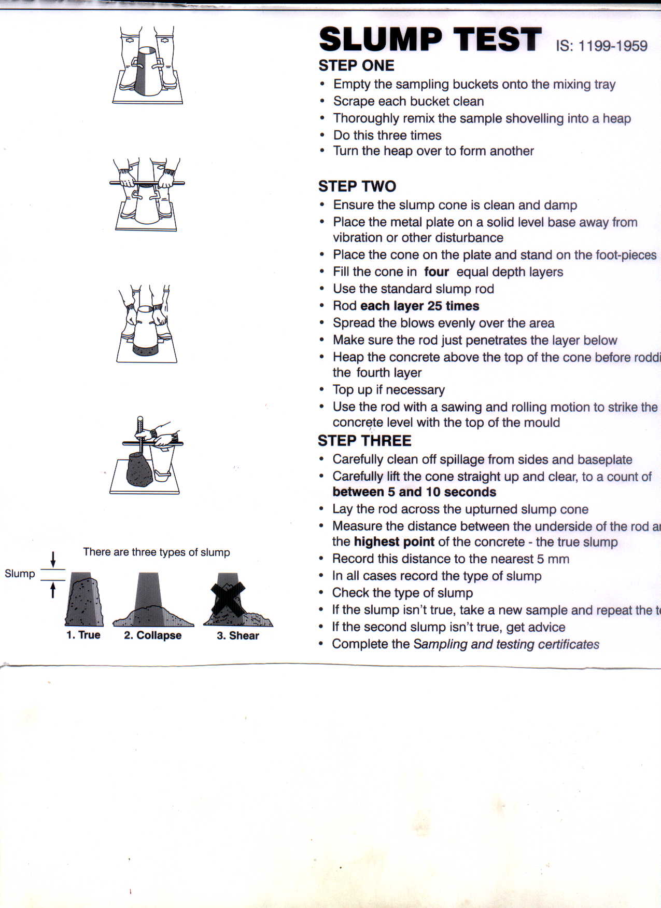



Slide 29
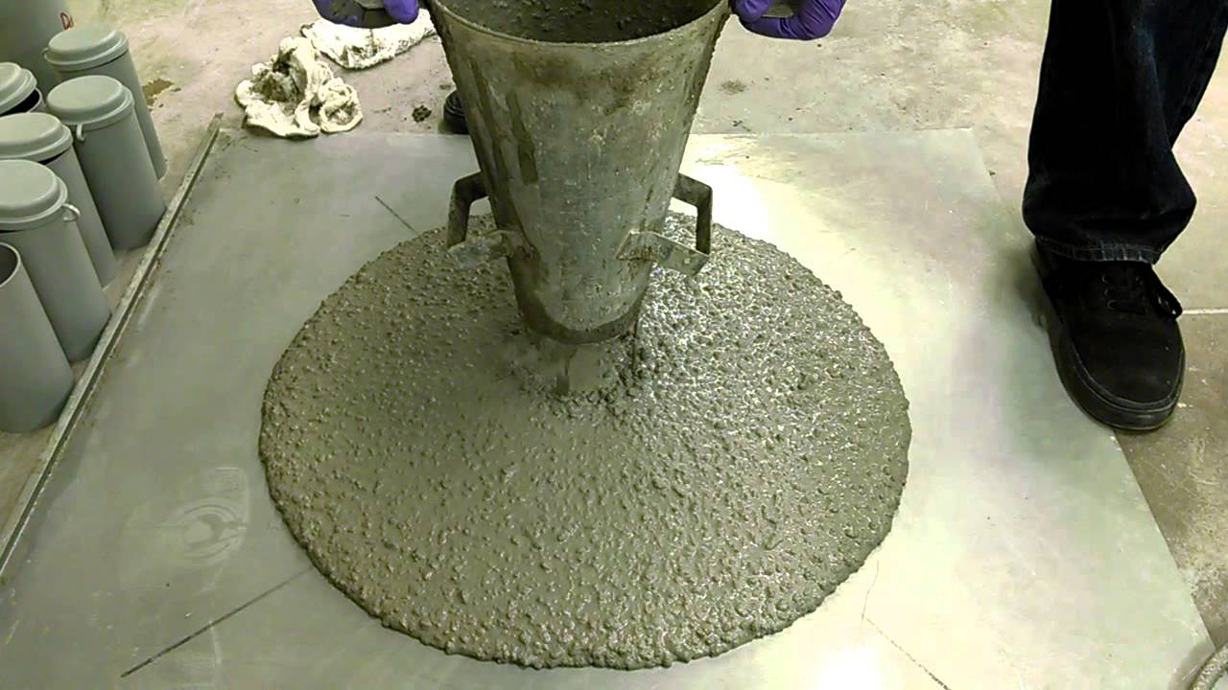

Slide 30
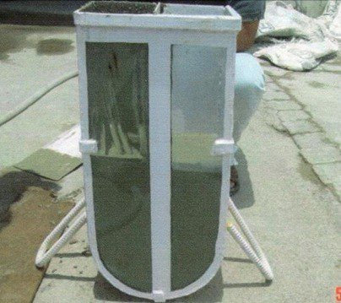

Slide 31
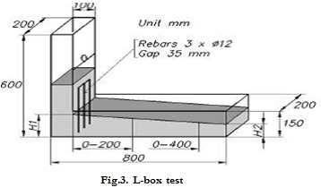

Slide 32
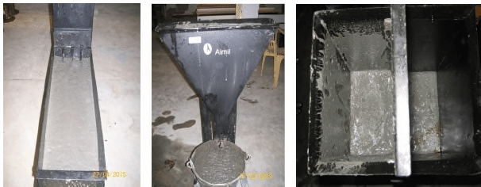

Slide 33



Slide 34


Slide 35
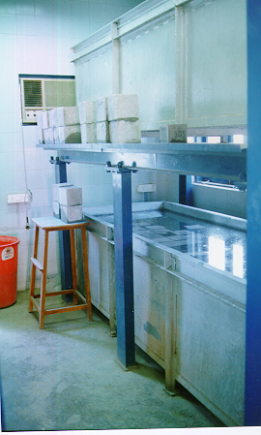
Curing Room
with Tanks
Temperature
controlled

Slide 36
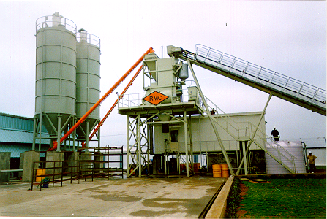
KEY ASPECTS OF SAMPLING, CUBE
MAKING, CURING AND TESTING
REPRESENTATIVE SAMPLE FROM TRUCK MIXER
REMIXING OF SAMPLE
STANDARD CUBE MOULDS ASSEMBLED AND OILED
FULL COMPACTION OF EACH LAYER
MAINTAINING CUBE MOIST OVERNIGHT
CURING CUBES UNDER STANDARD CONDITIONS
OBSERVATION OF CUBE FAULTS,
ACCURATE MEASUREMENT OF DIMENSION & WEIGHT
ACCURATE MEASUREMENT OF DENSITY & STRENGTH

Slide 37
TRUE AVERAGE CUBE STRENGTH OF
BATCH OF CONCRETE (100%)
SAMPLING ERROR
FAILURE TO REMIX SAMPLE
DISTORTED CUBE MOULD; LACK OF
MOULD OIL
INCOMPLETE COMPACTION OF CONCRETE
CURING TEMPERATURE OUTSIDE
OF PERMITTED RANGE
LACK OF CONTINUOUS
MOIST CURING
FAULTY CUBE LOCATION IN MACHINE OR
OTHER OPERATOR FAULT
FAULTY TEST MACHINE
Strength of cube relative to true
average cube strength of batch of concrete
-30
-20
-10
0
+10
-40
%

Slide 38

4. Workability
This is one of the major & very important ways of assessing the quality of concrete received on site.
Workability shall be within the range as defined in IS 4926, which is
Slump range=Required slump±25mm or 1/3 rd of the slump whichever is smaller.

Slide 39
05 PRESCRIBED MIX
If the mix proportions are given by the customer it is the customers responsibility to ensure that all desired properties are met and the RMC producer only mixes and gives the concrete to the customer.

Slide 40
FORWARD CONTROL
Materials storage
Prevention of contamination
Reliable transfer and feed systems
Drainage of aggregates
Monitoring of qualities of materials
Visual checks-acceptance/rejection, Sampling, testing, certification by suppliers information from suppliers

Slide 41
MODIFICATION OF MIX DESIGNS PLANT MAINTAINANCE TRANSFER AND WEIGHING EQUIPMENT
CONTROLLED FLOW
CALIBRATED WEIGH SCALES
CALIBRATED ADMIXTURE DISPENSERS
PLANT MIXERS AND TRUCK MIXERS
BLADE CONDITION
MIXER POWER
MAINTAINANCE

Slide 42
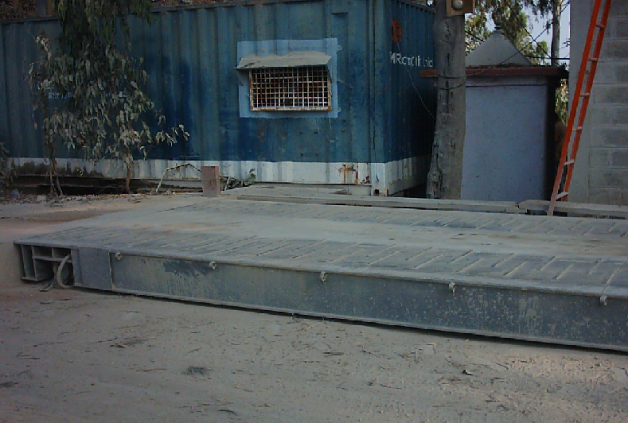

Slide 43
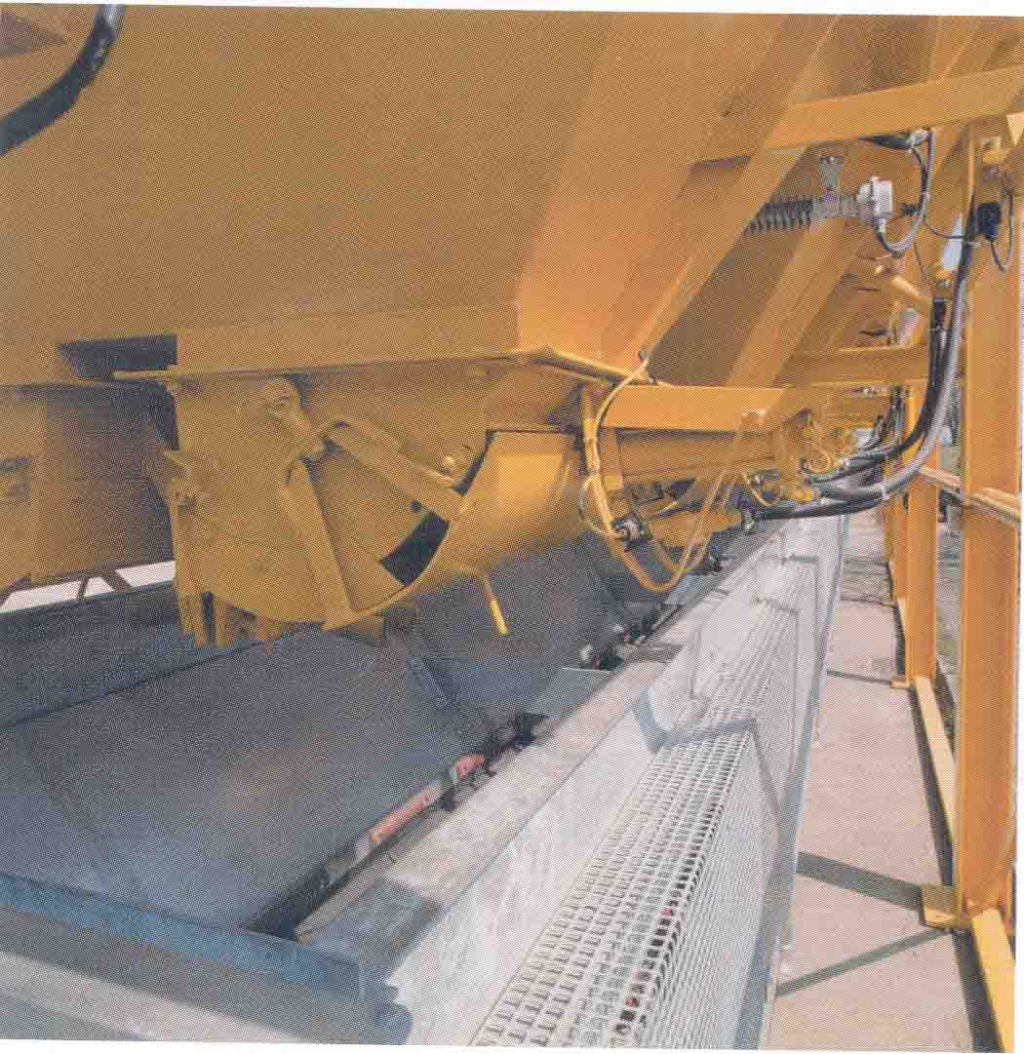
Weighing Belt Conveyor.

Slide 44
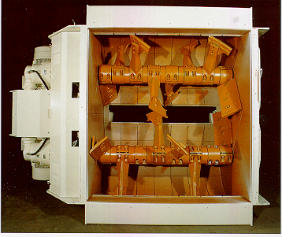
TWIN SHAFT MIXER

Slide 45
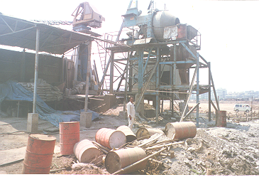

Slide 46
Immediate control
Correct batching
Visual observation of concrete sample during production and/or delivery or during sampling /testing in fresh state.
Moisture content control/usage of moisture probes or other means especially for fine aggregates
Making required adjustments at the plant automatically or manually to allow for observed, reported changes in materials or concrete qualities
Inspection at delivery point by technician or any company rep and adjustments to the workability within company policy.

Slide 47
RETROSPECTIVE CONTROL
SAMPLING OF CONCRETE,TESTING,MONITORING
CHECK OF WEIGHTS OF TRUCKS ON WEIGH BRIDGE (Empty and loaded)
Stock control of materials
Diagnosis and correction of faults identified from complaints
Analysis of cube results, statistical analysis.

Slide 48
CHECKS AT SITE
TIME OF BATCHING
RIGHT W/C RATIO
RIGHT SLUMP AT SITE
TO BE USED WITHIN APPROPRIATE TIME.
BATCHING TOLERANCES

Slide 49
SLUMP RANGE
SLUMP LESS;
ADD CHEMICAL ADMIXTURE ON SITE
As per ACI 212.4 R, IS4926

Slide 50
SLUMP MORE THAN SPEC
MORE WATER? (Higher w/c, lesser strength?)
Increase in coarser materials?
Increase in chemical admixture?
Wrong batching? (may be lesser ingredients?
A different cement or same cement brand with different properties/chemical composition?
Check before accepting ,check all details
May insist RMC to certify the batch?

Slide 51
INFORMATION TO BE PROVIDED BY PRODUCER
To fulfill the requirements of IS 4926-2003, when requested the producer has to furnish the following information
A)Nature & Source of each constituent.
b) Source of supply of cement.
c) Proposed proportions or quantities of each.
d) Information on generic type(s) of main constituents of admixtures, whether it is dosage free, whether the dosage causes air entrainment, compatibility when more than one admixture is used and also initial, final setting time of concrete when used at proposed dosage (tested as per IS8142).
DELIVERY TICKET
Should be as per IS 4926 ANNEXURE D

Slide 52
FULL CHECK LIST
MATERIALS AS PER IS 456-2000.
MATERIALS TESTING AS PER IS 4926 OR AS PER WELL DEFINED COMPANY QUALITY MANUAL.
STEPS AT BATCH PLANT TO PREVENT CONTAMINATION.
CALIBRATION OF BATCH PLANT.
MAINTAINANCE OF BATCH PLANT, TRUCKS, WEIGH SCALES,
CALIBRATION OF LAB EQUIPMENTS
CHECKS @BATCH PLANT.
CHECKS AT SITE
FORWARD, INTERMEDIATE & RETROSPECTIVE CONTROLS.
DELIVERY TICKETS, INFORMATION TO PURCHASER AS PER IS 4926.

Slide 53

THANK YOU

